Slide 1
Structure Programming
ICT-1105
Information and Communication Technology
Lecture-04
Date:

Slide 2
Class contents has given in Google Classroom with code
nhauiw4
Notes:
AT&T – American Telephone & Telegraph Company

Slide 3
What is C?
C is a programming language developed at AT & T’s Bell Laboratories of USA in 1972. It was designed and written by Dennis Ritche. Dennis Ritchie is known as the founder of C language.
It was developed to overcome the problems of previous languages such as B, BCPL etc.
Initially, C language was developed to be used in UNIX operating system.
Notes:
AT&T – American Telephone & Telegraph Company

Slide 4
Features of C
Portability or machine independent
Sound and versatile language
Fast program execution.
An extendible language.
Tends to be a structured language.

Slide 5
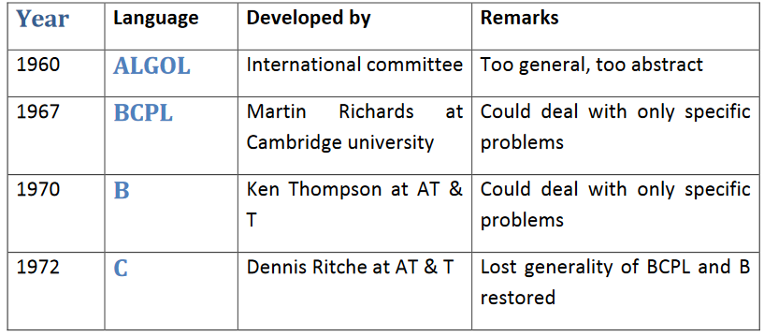
Historical developments of C(Background)
Notes:
ALGOL is Algorithmic Language
BCPL is Basic Combined Programming Language
COBOL is Common Business Oriented Language
Fortran is Formula Translation.

Slide 6
Brief History of C
The C programming language is a structure oriented programming language, developed at Bell Laboratories in 1972 by Dennis Ritchie.
C programming language features were derived from an earlier language called “B” (Basic Combined Programming Language – BCPL)
C language was invented for implementing UNIX operating system.

Slide 7
Brief History of C
In 1978, Dennis Ritchie and Brian Kernighan published the first edition “The C Programming Language” and is commonly known as K&R C.
In 1983, the American National Standards Institute (ANSI) established a committee to provide a modern, comprehensive definition of C. The resulting definition, the ANSI standard, or “ANSI C”, was completed late 1988.
Many of C’s ideas & principles were derived from the earlier language B, thereby naming this new language “C”.

Slide 8
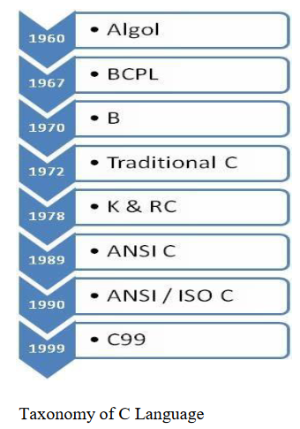
Brief History of C

Slide 9
WHY IS C POPULAR?
It is reliable, simple and easy to use.
C is a small, block-structured programming language.
C is a portable language, which means that C programs written on one system can be run on other systems with little or no modification.
C has one of the largest assortments of operators, such as those used for calculations and data comparisons.
Although the programmer has more freedom with data storage, the languages do not check data type accuracy for the programmer.

Slide 10
WHY TO STUDY C
By the early 1980s, C was already a dominant language in the minicomputer world of Unix systems. Since then, it has spread to personal computers (microcomputers) and to mainframes.
Many software houses use C as the preferred language for producing word processing programs, spreadsheets, compilers, and other products.
C is an extremely flexible language—particularly if it is to be used to write operating systems.
Unlike most other languages that have only four or five levels of precedence, C has 15

Slide 11
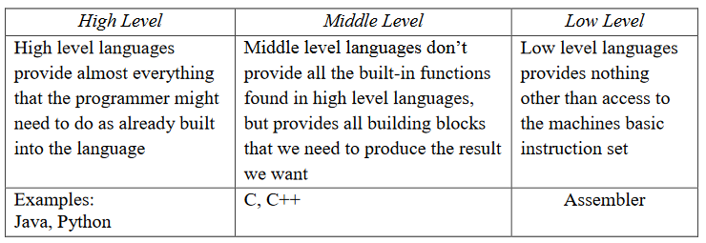
CHARECTERESTICS OF A C PROGRAM
Middle level language.

Slide 12
CHARECTERESTICS OF A C PROGRAM
Small size – has only 32 keywords
Extensive use of function calls- enables the end user to add their own functions to the C library.
Supports loose typing – a character can be treated as an integer & vice versa
Structured language

Slide 13
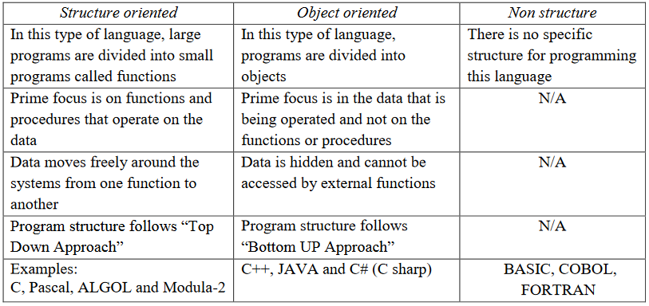
CHARECTERESTICS OF A C PROGRAM

Slide 14
CHARECTERESTICS OF A C PROGRAM
Low level (Bit Wise) programming readily available
Pointer implementation - extensive use of pointers for memory, array, structures and functions.
It has high-level constructs.
It can handle low-level activities.
It produces efficient programs.
It can be compiled on a variety of computers.

Slide 15
USES OF C
The C programming language is used for developing system applications that forms a major portion of operating systems such as Windows, UNIX and Linux. Below are some examples of C being used:
Database systems
Graphics packages
Word processors
Spreadsheets
Operating system development
Compilers and Assemblers
Network drivers
Interpreters

Slide 16
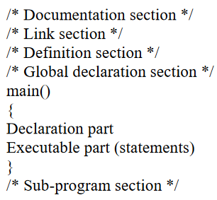
STRUCTURE OF A C PROGRAM

Slide 17
STRUCTURE OF A C PROGRAM
The documentation section is used for displaying any information about the program like the purpose of the program, name of the author, date and time written etc, and this section should be enclosed within comment lines. The statements in the documentation section are ignored by the compiler.
The link section consists of the inclusion of header files

Slide 18
STRUCTURE OF A C PROGRAM
The definition section consists of macro definitions, defining constants etc,.
Anything declared in the global declaration section is accessible throughout the program, i.e. accessible to all the functions in the program.
main() function is mandatory for any program and it includes two parts, the declaration part and the executable part.
The last section, i.e. sub-program section is optional and used when we require including user defined functions in the program.

Slide 19
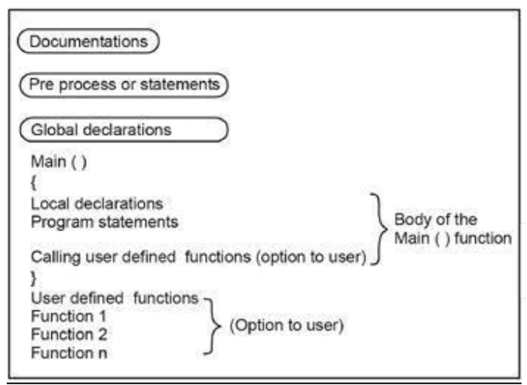
STRUCTURE OF A C PROGRAM

Slide 20
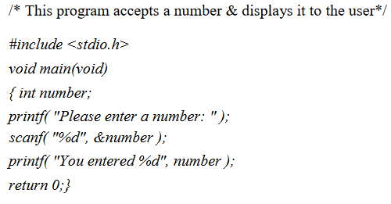
STRUCTURE OF A C PROGRAM
Based on this structure, we can sketch a C program.
Example:

Slide 21
STRUCTURE OF A C PROGRAM
#include
The part of the compiler which actually gets your program from the source file is called the preprocessor.
#include <stdio.h>
#include is a pre-processor directive. It is not really part of our program, but instead it is an instruction to the compiler to make it do something. It tells the C compiler to include the contents of a file (in this case the system file called stdio.h).
The compiler knows it is a system file, and therefore must be looked for in a special place, by the fact that the filename is enclosed in <> characters

Slide 22
STRUCTURE OF A C PROGRAM
<stdio.h>
stdio.h is the name of the standard library definition file for all STanDard Input and Output functions.
Your program will almost certainly want to send information to the screen and read things from the keyboard, and stdio.h is the name of the file in which the functions that we want to use are defined.
The function we want to use is called printf. The actual code of printf will be tied in later by the linker.
The ".h" portion of the filename is the language extension, which denotes an include file.

Slide 23
STRUCTURE OF A C PROGRAM
void
This literally means that this means nothing. In this case, it is referring to the function whose name follows.
Void tells to C compiler that a given entity has no meaning, and produces no error.

Slide 24
STRUCTURE OF A C PROGRAM
main
In this particular example, the only function in the program is called main.
A C program is typically made up of large number of functions. Each of these is given a name by the programmer and they refer to each other as the program runs.
C regards the name main as a special case and will run this function first i.e. the program execution starts from main.

Slide 25
STRUCTURE OF A C PROGRAM
(void)
This is a pair of brackets enclosing the keyword void.
It tells the compiler that the function main has no parameters.
A parameter to a function gives the function something to work on.

Slide 26
STRUCTURE OF A C PROGRAM
{ (Brace)
This is a brace (or curly bracket). As the name implies, braces come in packs of two – for every open brace there must be a matching close one.
Braces allow us to group pieces of program together, often called a block.
A block can contain the declaration of variable used within it, followed by a sequence of program statements.
In this case the braces enclose the working parts of the function main.

Slide 27
STRUCTURE OF A C PROGRAM
; (semicolon)
The semicolon marks the end of the list of variable names, and also the end of that declaration statement.
All statements in C programs are separated by ";" (semicolon) characters.
The ";" character is actually very important. It tells the compiler where a given statement ends.
If the compiler does not find one of these characters where it expects to see one, then it will produce an error.

Slide 28
STRUCTURE OF A C PROGRAM
scanf
In other programming languages, the printing and reading functions are a part of the language.
In C this is not the case; instead they are defined as standard functions which are part of the language specification, but are not a part of the language itself.
The standard input/output library contains a number of functions for formatted data transfer; the two we are going to use are scanf (scan formatted) and printf (print formatted).

Slide 29
STRUCTURE OF A C PROGRAM
printf
The printf function is the opposite of scanf.
It takes text and values from within the program and sends it out onto the screen.
Just like scanf, it is common to all versions of C and just like scanf, it is described in the system file stdio.h.
The first parameter to a printf is the format string, which contains text, value descriptions and formatting instructions.

Slide 30
FILES USED IN A C PROGRAM
Source File- This file contains the source code of the program. The file extension of any c file is .c. The file contains C source code that defines the main function & maybe other functions.
Header File- A header file is a file with extension .h which contains the C function declarations and macro definitions and to be shared between several source files.

Slide 31
FILES USED IN A C PROGRAM
Object File- An object file is a file containing object code, with an extension .o, meaning relocatable format machine code that is usually not directly executable. Object files are produced by an assembler, compiler, or other language translator, and used as input to the linker, which in turn typically generates an executable or library by combining parts of object files.

Slide 32
FILES USED IN A C PROGRAM
Executable File- The binary executable file is generated by the linker. The linker links the various object files to produce a binary file that can be directly executed

Slide 33
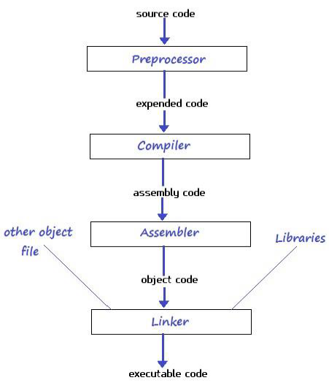
COMPLIATION & EXECUTION OF A C PROGRAM

Slide 34
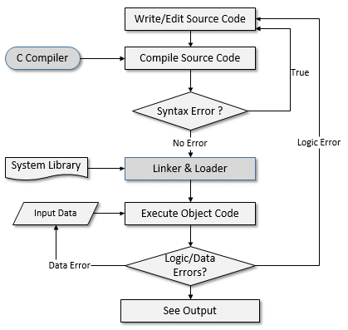
COMPLIATION & EXECUTION OF A C PROGRAM

Slide 35
Thank you….

